Slide 1

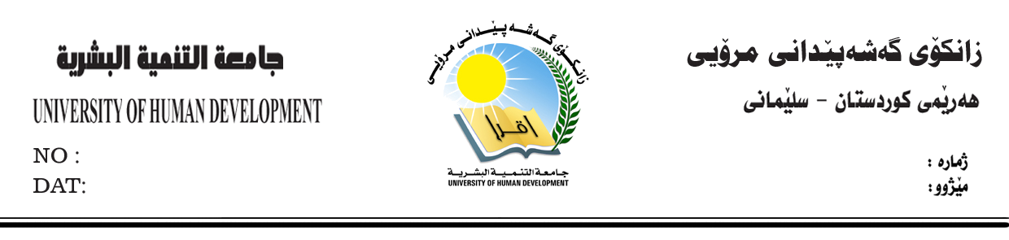


Diman Moammed
diman.mohammed@uhd.edu.iq

Slide 2



What is Academic Debate?
What is the goal?
What are the things debate teach you
Why should we debate?
Debate Format
Simple Debate Structure
The basic debating Skills
Diman Mohammed
College of Science and Technology
IT Department / Morning – 1st sage

Slide 3

Practice
Comparing
Contrasting
= Practice of COMPARING and CONTRASTING ideas
Diman Mohammed
College of Science and Technology
IT Department / Morning – 1st sage

Slide 4

COMPARING is showing similarities between persons, objects, and ideas
CONTRASTING is showing differences.
= Comparing and contrasting are ways to show relationships.
=We compare and contrast in some form every day.
Diman Mohammed
College of Science and Technology
IT Department / Morning – 1st sage

Slide 5
When somebody says I disagree with you!
They Don't Say I don't like you
=They Say the idea you had is wrong
- Like football game when you hit a footballer it doesn't mean you hate him he is a footballer and he's part of the game!
Diman Mohammed
College of Science and Technology
IT Department / Morning – 1st sage

Slide 6

Debate is not about trying to make the other person look bad
It is not about making yourself look big and good
The focus on debate is ON IDEAS
We SEARCH FOR TRUTH
And trying to find out THE BEST ANSWER
Diman Mohammed
College of Science and Technology
IT Department / Morning – 1st sage

Slide 7

√ We learn to know we not always right!
√ We learn to listen more to what people saying
X You don’t learn hand righting skills but note taking
Diman Mohammed
College of Science and Technology
IT Department / Morning – 1st sage

Slide 8

1. It is good for communication skills
2. Learn to research
3. Write note
4. Think critically
5. More comfortable arguing with people
Diman Mohammed
College of Science and Technology
IT Department / Morning – 1st sage
Notes:
This is to help you how to get out in front of any audience and share what is important to you , no matter what that audience are
Be more comfortable arguing with people in class your family and other , you gona be comfortable talking about all sort of topic and handle these kind of conversation

Slide 9

6. More informed
7. Build confident standing up in front of people
8. Learn logic and persuasion to persuade people
9. To line up your argument
Diman Mohammed
College of Science and Technology
IT Department / Morning – 1st sage

Slide 10

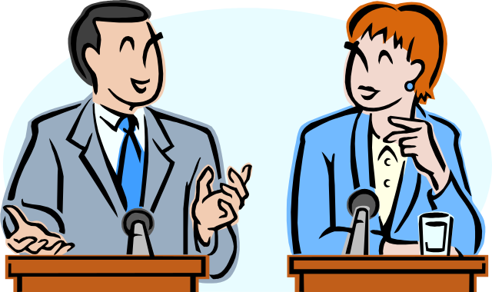
A debate means:
“a regulated discussion of a proposition by two matched sides, providing reasoned arguments for and against a proposition”
(Goodnight 1994)
Diman Mohammed
College of Science and Technology
IT Department / Morning – 1st sage

Slide 11

A debate is, simply put, an argument.
But rather than being a shouting match between two sides, a debate has strict rules of conduct, utilizing sophisticated techniques.
You may be put in a position where you must argue the opposite of what you believe in. This is an important part of the art of debating.
Diman Mohammed
College of Science and Technology
IT Department / Morning – 1st sage

Slide 12

A proposition is a STATEMENT that is open to interpretation
It shall be:
Controversial
Significant
Debatable
Diman Mohammed
College of Science and Technology
IT Department / Morning – 1st sage

Slide 13

The Affirmative
The Negative
Speaker 1
Introduction
Pro-argument 1
Conclusion
Speaker 1
Introduction
Rebuttal
Opposing argument 1
Conclusion
Speaker 2
Rebuttal
Pro-argument 2
Conclusion
Diman Mohammed
College of Science and Technology
IT Department / Morning – 1st sage

Slide 14

The Affirmative
The Negative
Speaker 2
Rebuttal
Opposing argument 2
Conclusion
Speaker 3
Rebuttal
Pro-argument 3
Powerful ending
Speaker 3
Rebuttal
Opposing argument 3
Powerful ending
Diman Mohammed
College of Science and Technology
IT Department / Morning – 1st sage

Slide 15

Style
Speed
tone
Volume
clarity
Use of notes and eye contact
content
General overview when you debate
Diman Mohammed
College of Science and Technology
IT Department / Morning – 1st sage

Slide 16
STYLE:
  Style is the manner in which you communicate your arguments. This is the most basic part of debating to master.
  Content and strategy are worth little unless you deliver your material in a confident and persuasive way.
SPEED:
  It is vital to talk at a pace which is fast enough to sound intelligent and allow you time to say what you want, but slow enough to be easily understood.
Diman Mohammed
College of Science and Technology
IT Department / Morning – 1st sage

Slide 17
TONE:
  Varying/ changeable tone is what makes you sound interesting.
  Listening to one tone for an entire presentation is boring.
VOLUME:
  Speaking too quietly is clearly disastrous
  and shouting does not win debates!
Diman Mohammed
College of Science and Technology
IT Department / Morning – 1st sage

Slide 18
CLARITY:
  The ability to concisely and clearly express complex issues & to keep it simple is what debating is all about.
USE OF NOTES & EYE CONTACT:
  Notes are essential, but they must be brief and well organized to be effective.
  Eye contact with the audience is very important, but keep shifting your gaze. No one likes to be stared at.
Diman Mohammed
College of Science and Technology
IT Department / Morning – 1st sage

Slide 19
CONTENT:
  Content is what you actually say in the debate. The arguments used to develop your own side’s case and rebut the opposite side’s.
Diman Mohammed
College of Science and Technology
IT Department / Morning – 1st sage

Slide 20

Exploring the Topic
  Coming up with Keywords
  Brainstorm ALL possible arguments for & against the topic
  Come up with as many arguments as possible to support your claim
  Think about possible rebuttal arguments
  Gather at least three pieces of evidence to support your claim
  Reaffirm your position by repeating the highlights of your evidence.
Diman Mohammed
College of Science and Technology
IT Department / Morning – 1st sage

Slide 21
2.Be extra prepared by:
  Search the web for debating videos.
  Have notes prepared, but do not let your debate become an oral presentation of a written essay.
  Practice speaking aloud in front of a mirror or other people.
  Understand both sides of the debate so that you are prepared to contradict the other side.
  Be ready to let go of small points.
  Concentrate on debating the main topics and prepared evidence.
Diman Mohammed
College of Science and Technology
IT Department / Morning – 1st sage

Slide 22
3. Seek to understand different views:
  Before trying to change others' views and opinions think that:
  They come from different backgrounds
  They have grown with different group of people
  May be because of their culture, religion, or general beliefs …….etc
  Never say the other person is wrong based on your ideas.
  Seek a way to learn from others' opinions
  Educate yourself so you might be wrong
  When another person says something really wrong, use patience.
Diman Mohammed
College of Science and Technology
IT Department / Morning – 1st sage

Slide 23


Diman Mohammed
College of Science and Technology
IT Department / Morning – 1st sage

